Slide 1


Topic Name: Skin Cancer Detection
IOT PROJECT
Name of the Student | Application No
Adithya V | R25EH004
Jayanth S | R25EH053
Darshan Gowda M | R25EH038
KC Preetham | R25EH054
Faculty In-charge: Prof. Pratima A
Assistant Professor
REVA University, Bengaluru

Slide 2
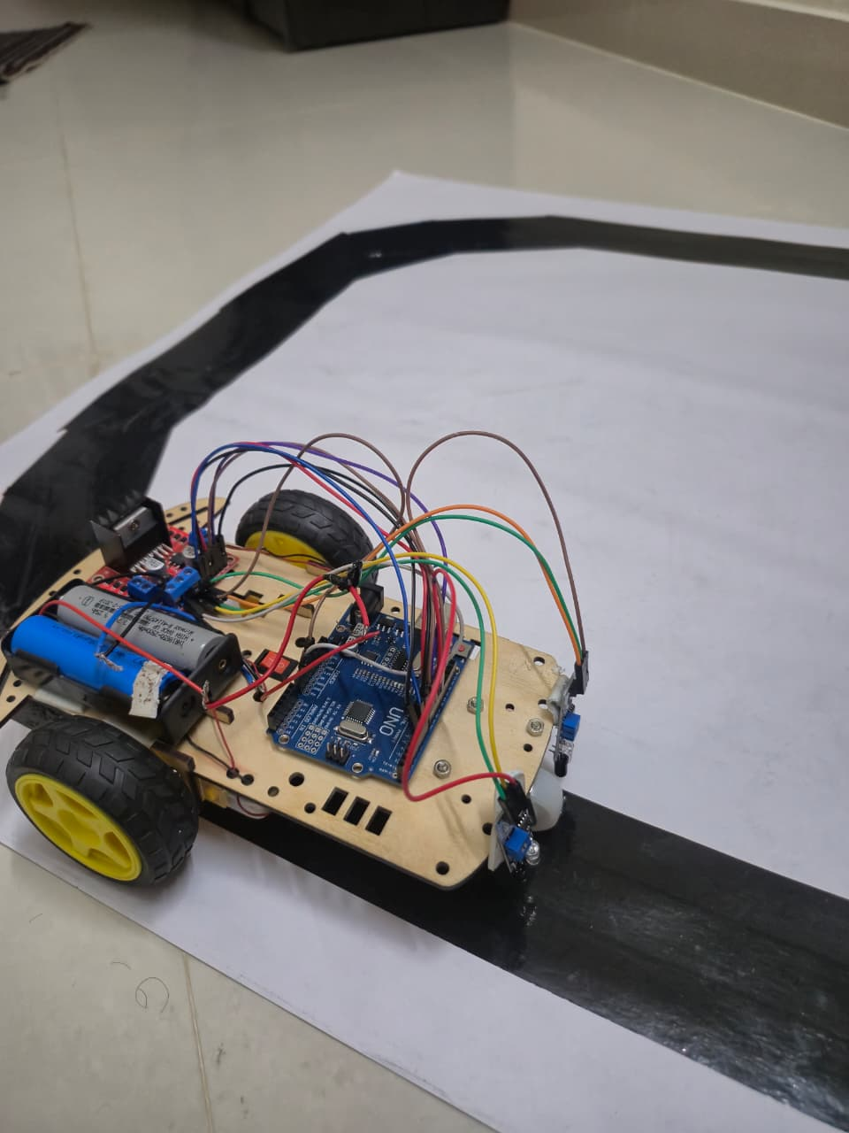
outline
1. Introduction
2. Abstract
Objectives
Methodology
Components Used
6. Working Procedure
7. Applications
Advantages
Conclusion
10. Future Trend

Slide 3
Introduction
Skin cancer is a major global health concern, with millions of new cases reported every year. It occurs due to the abnormal and uncontrolled growth of skin cells, primarily caused by excessive exposure to ultraviolet (UV) radiation from sunlight or artificial sources such as tanning beds. The most common types of skin cancer include basal cell carcinoma, squamous cell carcinoma, and melanoma. Among these, melanoma is considered the most dangerous form as it can spread rapidly to other parts of the body if not detected at an early stage.
Traditional methods for detecting skin cancer rely on visual examination by dermatologists followed by biopsy and laboratory analysis. Although these methods are accurate, they are expensive, time-consuming, and require access to specialized medical facilities. In rural and underdeveloped regions, such facilities are often unavailable, leading to delayed diagnosis and increased mortality rates.
Recent advancements in artificial intelligence and machine learning have enabled automated analysis of medical images with high accuracy. AI-based image classification systems can identify patterns related to color, texture, and shape that indicate abnormal skin lesions. Embedded systems such as the ESP32-CAM provide an affordable platform for image acquisition and processing. This project focuses on developing a low-cost AI-powered skin lesion detection system using the ESP32-CAM module to assist in early screening and raise awareness among users.

Slide 4

Abstract
Skin cancer is one of the fastest-growing cancers worldwide.
Early detection greatly improves treatment success.
Access to dermatologists is limited in many rural areas.
This project uses an ESP32-CAM and AI for skin lesion screening.
The system captures images and classifies lesions as normal or suspicious.
It is low-cost, portable, and easy to use.
The solution can support early diagnosis and improve healthcare accessibility.

Slide 5
Objectives
To design and develop an AI-powered system for early detection of skin cancer
To capture images of skin lesions using the ESP32-CAM module
To preprocess and analyze images using a trained machine learning model
To classify skin lesions as normal or suspicious
To provide a low-cost, portable, and efficient preliminary screening tool
To demonstrate the integration of artificial intelligence with embedded hardware

Slide 6
Components Used
ESP32-CAM Module – Used for capturing skin lesion images
USB-to-TTL Programmer – Used for programming the ESP32-CAM

Slide 7
Methodology – Skin Cancer Detection
Power Supply: USB Supply
Image Acquisition: ESP32-CAM Module
Image Processing: OpenCV
AI Processing: TensorFlow/TensorFlow lite
Output: Normal / Suspicious Classification
Workflow: ESP32-CAM → Preprocessing → AI Model → Prediction

Slide 8
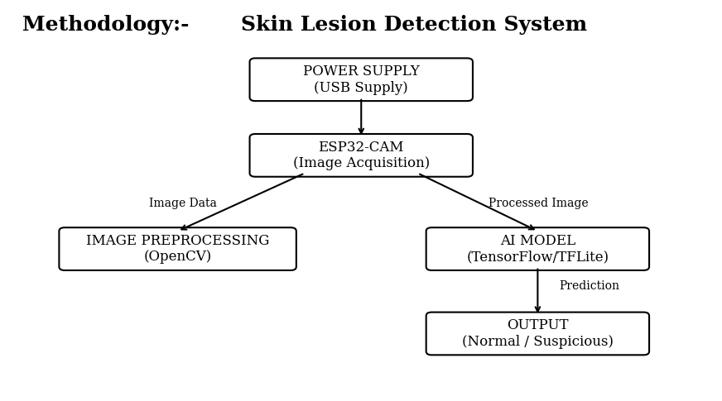

Slide 9
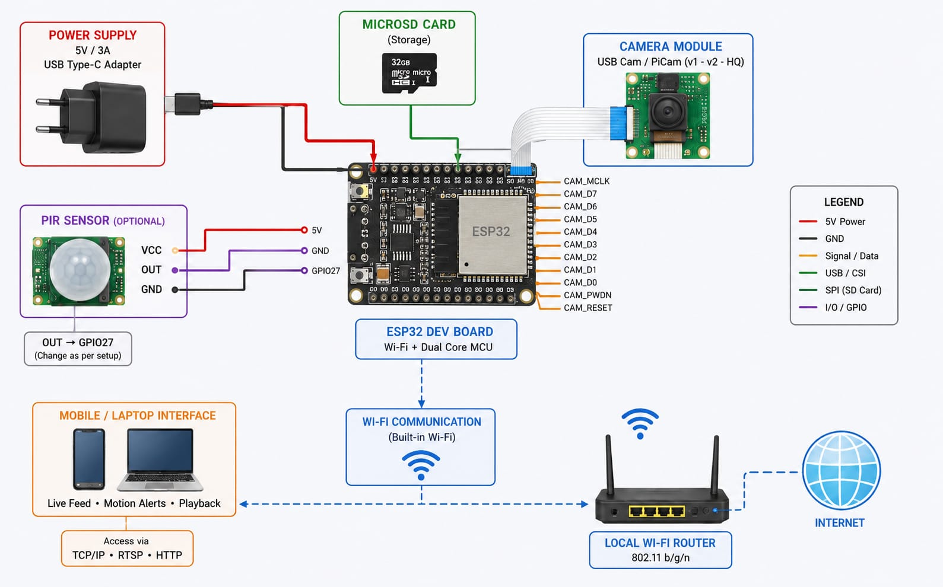
Connections

Slide 10
Working Principle
ESP32-CAM captures the lesion image.
The image is transferred for processing.
OpenCV preprocesses the image.
TensorFlow extracts lesion features.
The AI model predicts the lesion type.
Results are displayed to the user.
Suspicious cases are advised for medical consultation.

Slide 11
Applications
Preliminary skin cancer screening.
Rural healthcare centers.
Telemedicine support.
Community health camps.
Home-based monitoring.
Medical awareness programs.
Educational demonstrations.

Slide 12
Advantages
Low-cost implementation.
Portable and compact.
Easy to operate.
Faster preliminary screening.
Improves healthcare accessibility.
Encourages early diagnosis.
Suitable for remote areas.
Demonstrates AI–IoT integration.

Slide 13
Disadvantages
Cannot replace dermatologist diagnosis.
Accuracy depends on training dataset.
Lighting variations affect performance.
Limited processing capability of ESP32-CAM.
Restricted to preliminary screening.
Requires further clinical validation.

Slide 14
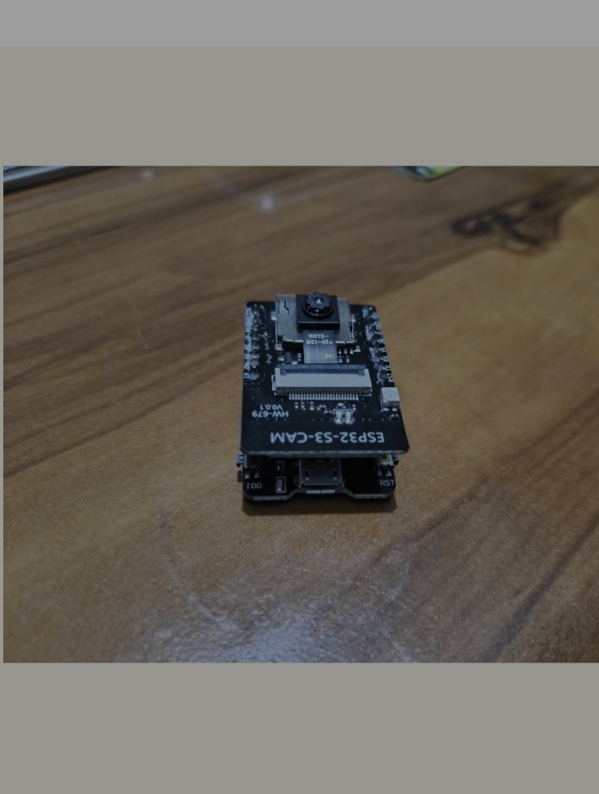
Image

Slide 15
Conclusion
Developed an AI-assisted skin lesion detection prototype.
Successfully integrated ESP32-CAM with machine learning.
Provided a low-cost healthcare screening approach.
Increased awareness regarding early detection.
Demonstrated practical IoT healthcare applications.
Shows potential for real-world implementation.

Slide 16
Future Scope
Improve model accuracy using larger datasets.
Detect multiple skin diseases.
Develop a mobile application.
Integrate cloud connectivity.
Enable remote healthcare monitoring.
Support telemedicine platforms.
Generate automated reports.

Slide 17
References
Technical Documentation
ESP32-CAM Datasheet – Espressif Systems
TensorFlow Lite Documentation – Google
OpenCV Documentation – OpenCV Foundation
Research Papers
Skin Cancer Classification Using Deep Learning Techniques
Automated Skin Lesion Analysis Using Convolutional Neural Networks (CNN)
AI-Based Skin Disease Detection Systems
Online Resources
ESP32 Official Documentation
TensorFlow Lite Official Website
OpenCV Official Website
Kaggle Skin Cancer Dataset (HAM10000)
Software Tools
Arduino IDE (Programming Environment)

Slide 18


